Slide 1
ATLIQ SALES ANALYSIS USING POWER BI

Slide 2
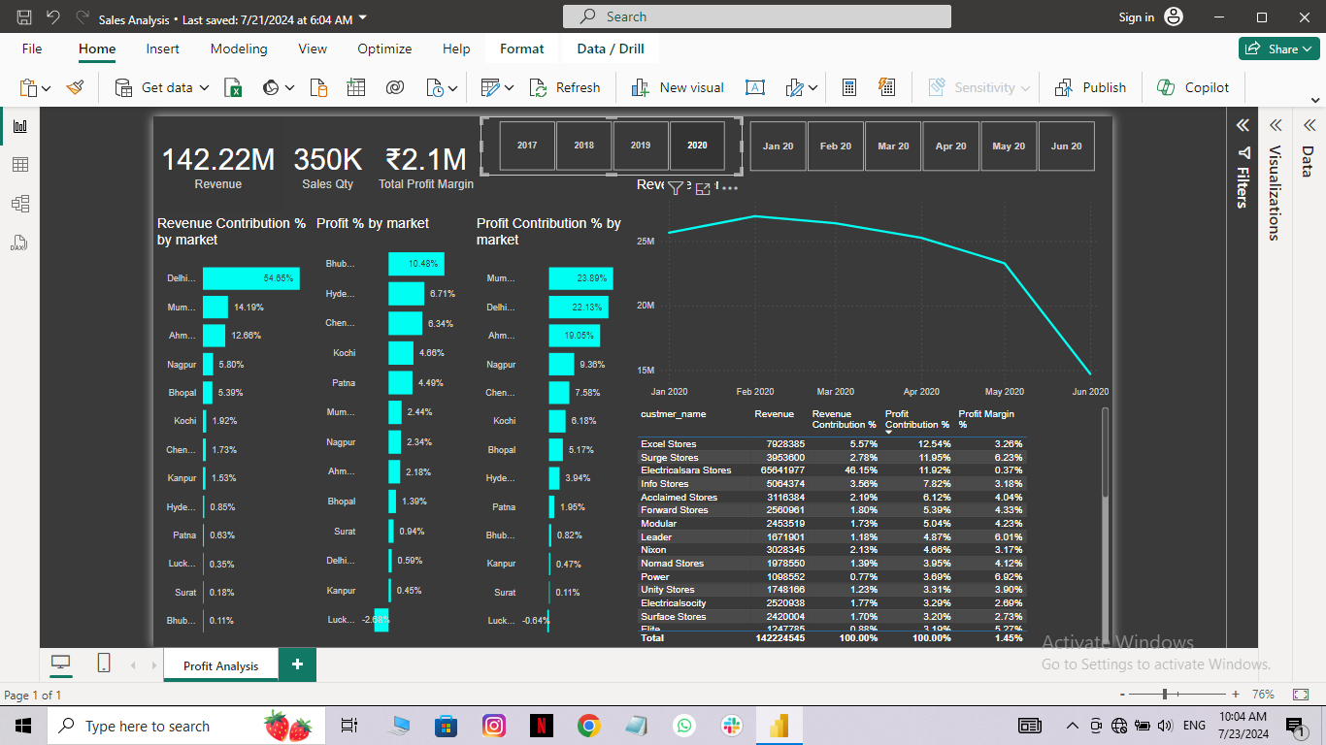
Revenue Contribution Percentage by Market
Delhi has the highest revenue contribution at 54.66%, followed by Mumbai at 14.19% and Ahmedabad at 12.66%.
Other markets have significantly lower contribution.
Marketing should focus on the markets which are contributing less.

Slide 3
Profit Percentage by Market
Bhubaneswar leads in profit percentage at 10.48%, with Hyderabad and Chennai contributing 6.71% and 6.34% respectively.
Other markets contribute less significantly.
Interestingly maximum revenue is contributed by Delhi but maximum profit is generated by Bhubaneswar.
We should try to increase the revenue contribution of Bhubaneswar, Hyderabad, Chennai, etc.

Slide 4
Profit Contribution Percentage by Market
Despite revenue contribution of Delhi is more but Mumbai contributes more profit.
Mumbai and Delhi are the major contributors to profit at 23.89% and 22.13% respectively, followed by Ahmedabad at 19.06%.
Other markets have a similar share in profit contribution.

Slide 5
Revenue vs Sum of Sales Amount
The revenue peaked in February 2020 and has been gradually decreasing since then, with a noticeable drop in June 2020.

Slide 6
Customer and their Contribution
Excel Stores has the highest profit contribution at 12.54%, followed by Surge Stores at 11.95%, despite Electricalsara Stores Revenue contribution is highest at 46.15% but Profit contribution is less compared to Excel Stores and Surge Stores.

